Slide 1
DIGITAL PORTFOLIO
NAME:BALAMURUGAN M
REG NO:20324U09005
NMID:7CBCFBD2E9414399204439A4227B625F
COLLEGE NAME:DR. M. G. R. Chockalingam Arts COLLEGE
UNIVERSITY: THIRUVALLUVAR UNIVERSITY

Slide 2
PROJECT TITLE
DIGITAL PORTFOLIO WEBSITE USING WEB DEVELOPMENT

Slide 3
AGENDA
Problem Statement
Project Overview
End Users
Tools and Technologies
Portfolio Design and Layout
Features and Functionality
Result and Screenshot
Conclusion
Github Link

Slide 4
Problem Statement
In today’s digital era, a strong online presence is essential.
Many students and developers lack a personal portfolio site.
Without it, showcasing skills to recruiters becomes difficult.
Traditional resumes are static and less engaging.
There is a need for an interactive, responsive portfolio site.
This project aims to solve that problem effectively.

Slide 5
Project Overview
This project is a personal portfolio website.
Developed using HTML, CSS, and JavaScript.
It consists of sections like About, Projects, and Contact.
Focuses on simplicity, responsiveness, and usability.
Acts as a digital resume and project showcase.
Highlights front-end development skills.

Slide 6
End Users
Students can use it to present their skills.
Job seekers benefit by showcasing projects online.
Recruiters can evaluate candidates quickly.
Freelancers can attract potential clients.
Anyone in IT can maintain a digital identity.
General users can get inspired by the design.

Slide 7
Tools and Technologies
HTML – for structuring the website.
CSS – for styling and responsive design.
JavaScript – for smooth interactions.
Visual Studio Code – development environment.
GitHub – for hosting and version control.
Browser tools – for testing and debugging.

Slide 8
Portfolio Design and Layout
The layout includes sections like Header, Hero, About, and Projects.
Navigation bar allows smooth movement across sections.
Hero section introduces the developer attractively.
Projects are displayed in a grid layout with images.
Contact form included for user interaction.
Footer contains credits and copyright.

Slide 9
Features and Functionality
Responsive design adapts to all devices.
Smooth scrolling navigation with JavaScript.
Interactive buttons for better user experience.
Projects displayed with thumbnails and details.
Contact form for user communication.
Lightweight and fast-loading pages.

Slide 10
Results and Screenshots
The website successfully showcases portfolio content.
User-friendly navigation and design confirmed.
Responsive layout works across devices.
Interactive features improve engagement.
The project demonstrates technical skills clearly.
Screenshot of the output is shown below:

Slide 11
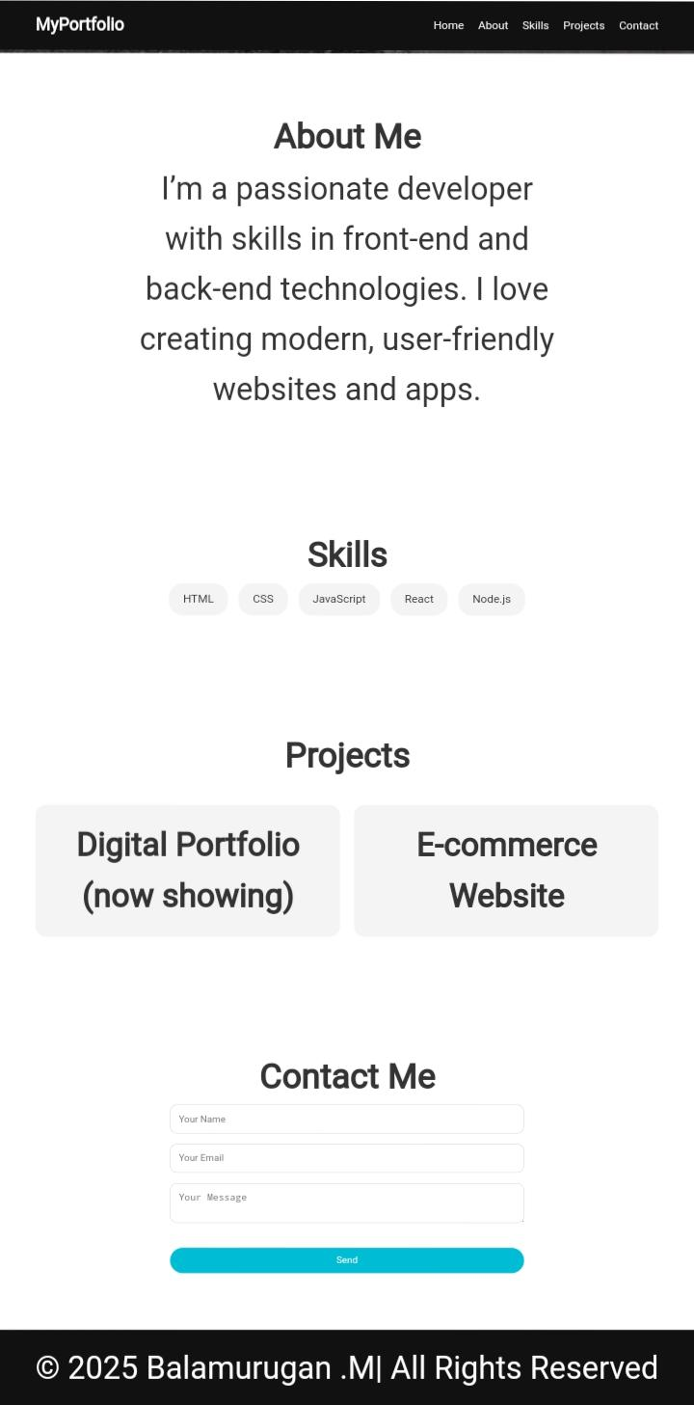
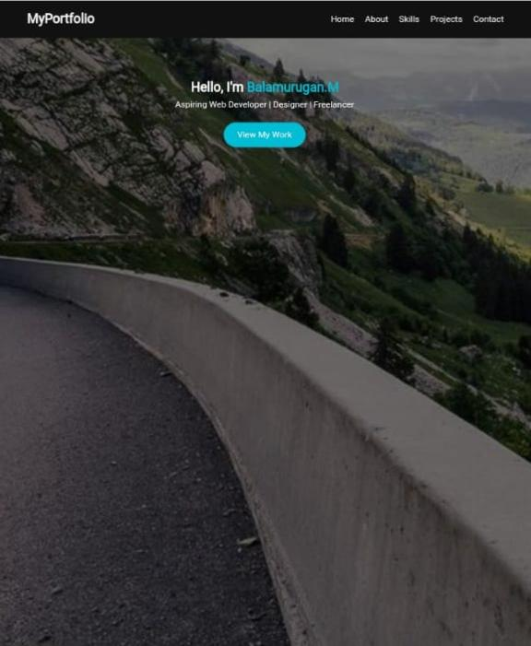
SCREENSHOTS

Slide 12
Conclusion
The project highlights web development skills.
It shows ability to use HTML, CSS, and JavaScript effectively.
Portfolio provides a professional online identity.
Practical implementation of front-end concepts achieved.
Useful for career building and client engagement.
Can be improved by adding backend features.

Slide 13
GitHub Link
https://github.com/balamurugan20324u09005-pixel/Balamurugan.M.git

